Slide 1
COMP 6246
Machine Learning Technologies
Deep Learning
Dr Mohammad Soorati
School of Electronics and Computer Science
University of Southampton

Slide 2
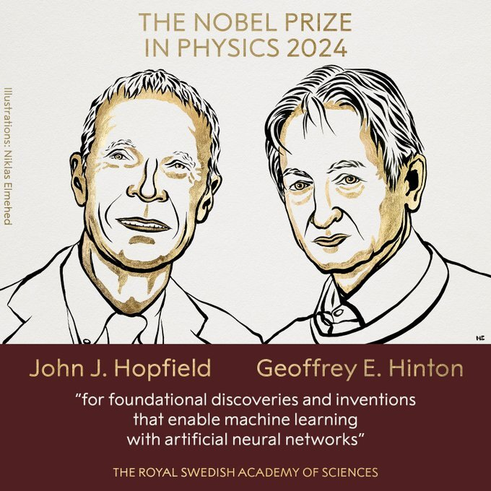
Deep learning
Prof. Geoffrey Hinton , "Will digital intelligence replace biological intelligence?”
https://youtu.be/N1TEjTeQeg0?si=6Mpvf63oQ0GGXy

Slide 3
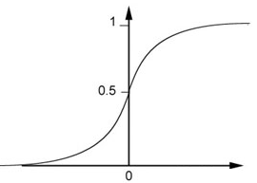

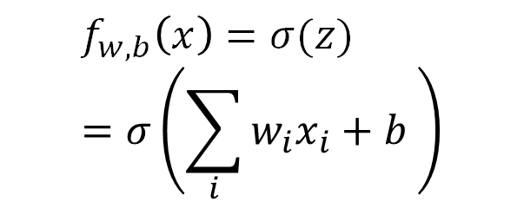
Logistic Regression
…
…
$$f_{w,b}\left(x\right)=σ(z)=σ\left(\sum_{i}{w_{i}x_{i}}+b \right)$$
…
…
Sigmoid Function
$$f_{w,b}\left(x\right)=σ\left(z\right)>0.5, the data in class 1$$

Slide 4
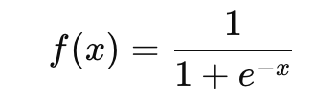
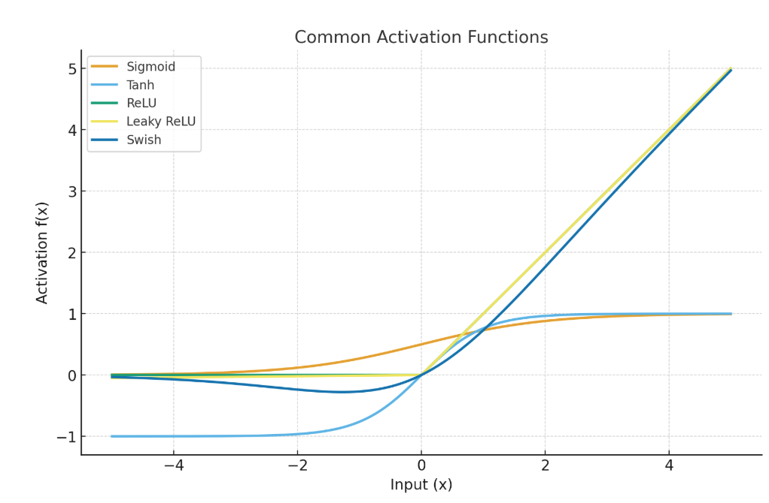
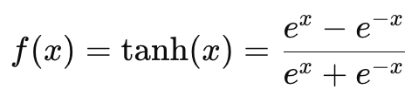

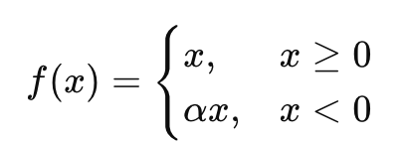

Activation Functions
Sigmoid
Tanh
ReLU
Leaky ReLU
Swish
…
Notes:
Many fns of variance
Anything below 0, answer is 0 if above then any no depend on if 3 then 3

Slide 5
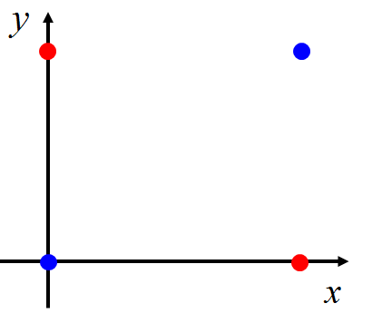
Limitation of Logistic Regression
Input Feature |  | Label
x₁ | x₂
0 | 0 | Class 2
0 | 1 | Class 1
1 | 0 | Class 1
1 | 1 | Class 2
z ≥ 0
z < 0
z < 0
z ≥ 0
Notes:
Operators
Xor
Nor

Slide 6











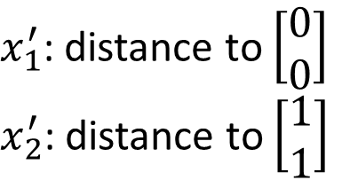
Limitation of Logistic Regression
$x_{1}^{′}$: distance to $\left[\begin{aligned}0 \\ 0\end{aligned}\right]$
$x_{2}^{′}$: distance to $\left[\begin{aligned}1 \\ 1\end{aligned}\right]$
Feature Transformation
$$\left[\begin{aligned}x_{1} \\ x_{2}\end{aligned}\right]$$
$$\left[\begin{aligned}x_{1}^{′} \\ x_{2}^{′}\end{aligned}\right]$$
Not always easy to find a good transformation
$$x_{2}^{′}$$
$$\left[\begin{aligned}0 \\ \sqrt{2}\end{aligned}\right]$$
$$\left[\begin{aligned}0 \\ 1\end{aligned}\right]$$
$$\left[\begin{aligned}1 \\ 1\end{aligned}\right]$$
$$\left[\begin{aligned}0 \\ 0\end{aligned}\right]$$
$$\left[\begin{aligned}1 \\ 0\end{aligned}\right]$$
$$\left[\begin{aligned}1 \\ 1\end{aligned}\right]$$
$$\left[\begin{aligned}\sqrt{2} \\ 0\end{aligned}\right]$$
$$x_{1}^{′}$$
Notes:
Classifer that can split it

Slide 7
Feature Transformation
- Can increase complexity-
- May cause information loss
- Can increase the number of features
- Interpretability may decrease
Notes:
Hard to interpret why what certain decision

Slide 8


Limitation of Logistic Regression
Cascading logistic regression models
$$x_{1}^{′}$$
$$x_{2}^{′}$$
Feature Transformation
Classification
(ignore bias in this figure)

Slide 9
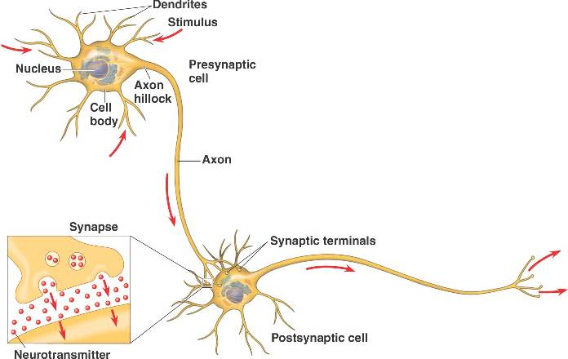
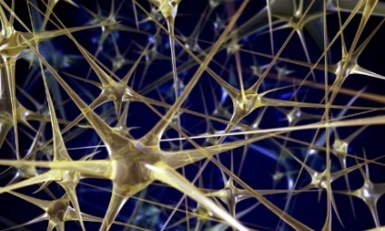
Neural Network
“Neuron”
Neural Network
Different connection leads to different network structures

Slide 10
Fully Connect Feedforward Network
neuron
Input
Layer 1
Layer 2
Layer L
Output
……
y₁
……
y₂
……
……
……
……
……
……
y_{M}
Input Layer
Output Layer
Hidden Layers

Slide 11
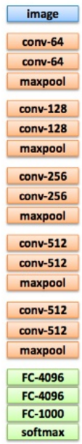
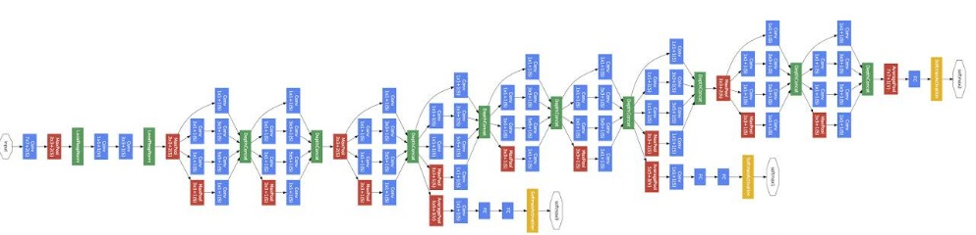
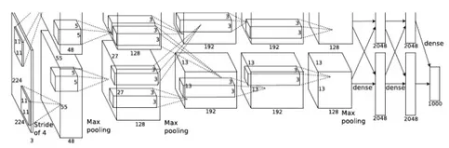
Deep = Many hidden layers
22 layers
http://cs231n.stanford.edu/slides/winter1516_lecture8.pdf
19 layers
8 layers
6.7%
7.3%
16.4%
AlexNet (2012)
VGG (2014)
GoogleNet (2014)

Slide 12
Deep = Many hidden layers
Deep neural network = a neural network with many hidden layers
152 layers
3.57%
7.3%
6.7%
16.4%
AlexNet (2012)
VGG
(2014)
GoogleNet
(2014)
Residual Net
(2015)
Notes:
More layers leaders to better learning

Slide 13
Fully Connect Feedforward Network
1
4
0.98
1
-2
1
-1
-2
0.12
-1
1
0
Sigmoid Function

Slide 14
Fully Connect Feedforward Network
1
4
0.98
2
0.86
3
0.62
1
-2
-1
-1
1
0
-2
-1
-2
0.12
-2
0.11
-1
0.83
-1
1
-1
4
0
0
2

Slide 15
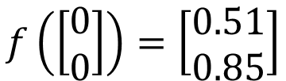
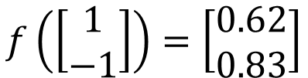
Fully Connect Feedforward Network
1
0.73
2
0.72
3
0.51
0
-2
-1
-1
1
0
-2
-1
0.5
-2
0.12
-1
0.85
0
1
-1
4
0
0
2
The neural network can be viewed as a function f
$$f\left(\left[\begin{matrix}1 \\ −1\end{matrix}\right]\right)=\left[\begin{matrix}0.62 \\ 0.83\end{matrix}\right]$$
$$f\left(\left[\begin{matrix}0 \\ 0\end{matrix}\right]\right)=\left[\begin{matrix}0.51 \\ 0.85\end{matrix}\right]$$

Slide 16
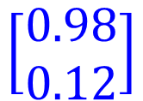


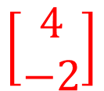

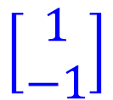

Matrix Operation
1
4
0.98
1
-2
1
-1
-2
0.12
-1
1
0
$$\left[\begin{matrix}1 & −2 \\ −1 & 1\end{matrix}\right]$$
$$\left[\begin{matrix}1 \\ −1\end{matrix}\right]$$
$$\left[\begin{matrix}1 \\ 0\end{matrix}\right]$$
$$=$$
$$\left[\begin{matrix}0.98 \\ 0.12\end{matrix}\right]$$
$$σ\left( \right)$$
$$+$$
$$\left[\begin{matrix}4 \\ −2\end{matrix}\right]$$

Slide 17



Neural Network
……
y₁
W¹
W²
W^{L}
……
y₂
b¹
b²
b^{L}
……
……
……
……
……
x
a¹
a²
y
……
y_{M}
W¹
x
b¹
+
$$σ\left( \right)$$
a¹
b²
W²
+
$$σ\left( \right)$$
W^{L}
b^{L}
a^{L-1}
+
$$σ\left( \right)$$

Slide 18


Neural Network
……
y₁
W¹
W²
W^{L}
……
y₂
b¹
b²
b^{L}
……
……
……
……
……
x
a¹
a²
y
……
y_{M}
y
x
$$=f\left( \right)$$
W^{L}
…
W²
W¹
x
b¹
b²
…
b^{L}
+
+
+
$$σ\left( \right)$$
$$=σ\left( \right)$$
$$σ\left( \right)$$
Network parameter $θ$: all the weights and biases in the “neurons”
x

Slide 19
Output Layer
Automatic feature engineering
……
y₁
……
y₂
Softmax
……
……
……
……
……
……
y_{M}
Input Layer
Output Layer
= Multi-class Classifier
Hidden Layers

Slide 20




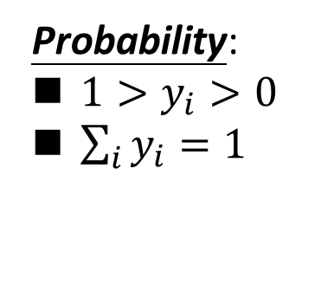


Multi-class Classification: Recap
C₁:
$$z_{1}=w^{1}∙x+b_{1}$$
Probability:
$1>y_{i}>0$
$\sum_{i}{y_{i}=1}$
$$w^{1},b_{1}$$
C₂:
$$w^{2},b_{2}$$
$$z_{2}=w^{2}∙x+b_{2}$$
C₃:
$$w^{3},b_{3}$$
$$z_{3}=w^{3}∙x+b_{3}$$
Softmax
3
20
0.88
1
2.7
0.12
-3
0.05
≈0

Slide 21




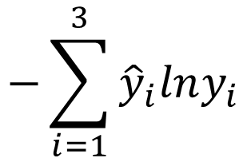


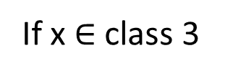

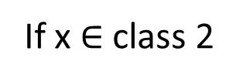



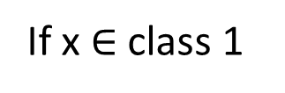
Multi-class Classification
$$z_{1}=w^{1}∙x+b_{1}$$
Cross Entropy
$$x$$
$$z_{2}=w^{2}\text{∙}x+b_{2}$$
Softmax
$$−\sum_{i=1}^{3}{{\hat{y}}_{i}lny_{i}}$$
$$z_{3}=w^{3}\text{∙}x+b_{3}$$
target
If x $∈$ class 1
If x $∈$ class 2
If x $∈$ class 3
$$\left[\begin{aligned}1 \\ 0 \\ 0\end{aligned}\right]$$
$$\left[\begin{aligned}0 \\ 1 \\ 0\end{aligned}\right]$$
$$\left[\begin{aligned}0 \\ 0 \\ 1\end{aligned}\right]$$
$$\hat{y}=$$
$$\hat{y}=$$
$$\hat{y}=$$

Slide 22
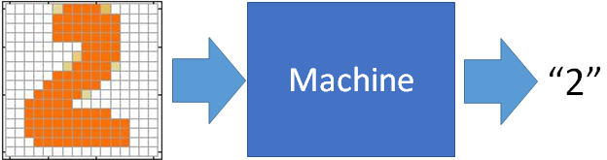
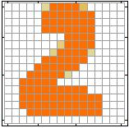
Example Application
Input
Output
y₁
is 1
0.1
y₂
is 2
0.7
The image is “2”
……
……
……
y₁₀
0.2
is 0
16 x 16 = 256
Ink → 1
No ink → 0

Slide 23
Example Application
Handwriting Digit Recognition
y₁
is 1
Machine
y₂
is 2
Neural
Network
“2”
……
……
……
y₁₀
is 0
What is needed is a function ……
Input:
256-dim vector
output:
10-dim vector

Slide 24




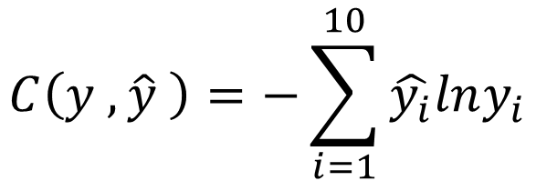


Loss For One Data
target
“1”
……
y₁
$${\hat{y}}_{1}$$
1
……
0
Train a set of parameters
y₂
$${\hat{y}}_{2}$$
Softmax
……
……
……
……
Cross
Entropy
……
……
……
y₁₀
0
$${\hat{y}}_{10}$$
$$C\left(y ,\hat{y} \right)=−\sum_{i=1}^{10}{\hat{y_{i}}lny_{i}}$$
$$y$$
$$\hat{y}$$

Slide 25





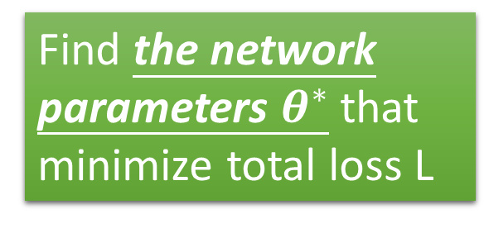







Total Loss
Total Loss:
$$L=\sum_{n=1}^{N}{C^{n}}$$
For all training data …
x¹
NN
y¹
$${\hat{y}}^{1}$$
$$C^{1}$$
NN
Find a function in function set that minimizes total loss L
x²
y²
$${\hat{y}}^{2}$$
$$C^{2}$$
x³
NN
y³
$${\hat{y}}^{3}$$
$$C^{3}$$
……
……
……
……
Find the network parameters $θ^{∗}$ that minimize total loss L
x^{N}
NN
y^{R}
$${\hat{y}}^{N}$$
$$C^{N}$$

Slide 26




Training Parameters
Input = 2, Desired Output = 4
$$w_{t}$$
$$x_{1}$$
$$y_{1}$$
$$b_{t}$$

Slide 27

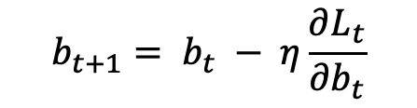
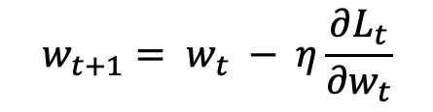
Backpropagation
Input = 2, Desired Output = 4
$$w_{t}$$
$$L_{t}=\frac{1}{2}{(y_{t} −\hat{y})}^{2}$$
$$x_{1}$$
$$y_{1}$$
$$y_{t}=x_{t}w_{t}+b_{t}$$
$$b_{t}$$
$$w_{t+1}= w_{t} − η\frac{∂L_{t}}{{∂w}_{t}}$$
$$b_{t+1}= b_{t} − η\frac{∂L_{t}}{{∂b}_{t}}$$
Notes:
Slope –ive we increase

Slide 28



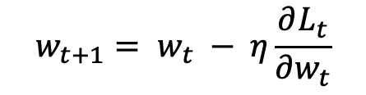

Backpropagation
$$w_{t+1}= w_{t} − η\frac{∂L_{t}}{{∂w}_{t}}$$
Input = 2, Desired Output = 4
$$w_{t}$$
$$L_{t}=\frac{1}{2}{(y_{t} −\hat{y})}^{2}$$
$$x_{1}$$
$$y_{1}$$
$$y_{t}=x_{t}w_{t}+b_{t}$$
$$b_{t}$$
$$w_{1}=0.5$$
$$x_{1}=2$$
$$\begin{matrix}y_{1}=2, & \hat{y}=4, & η=0.1\end{matrix}$$
$$b_{1}=1$$

Slide 29

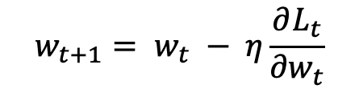





Backpropagation
$$w_{t+1}= w_{t} − η\frac{∂L_{t}}{{∂w}_{t}}$$
$$L_{t}=\frac{1}{2}{(y_{t} −\hat{y})}^{2}$$
$$y_{t}=x_{t}w_{t}+b_{t}$$
$$w_{1}=0.5$$
$$x_{1}=2$$
$$\begin{matrix}y_{1}=2, & \hat{y}=4, & η=0.1\end{matrix}$$
$$b_{1}=1$$
$\frac{∂L_{t}}{{∂w}_{t}}$ = $\frac{∂L_{t}}{{∂y}_{t}} ×\frac{∂y_{t}}{{∂w}_{t}}$
$$w_{2}= w_{1} − η\frac{∂L_{t}}{{∂w}_{t}}$$
$\frac{∂L_{t}}{{∂b}_{t}}$ = $\frac{∂L_{t}}{{∂y}_{t}} ×\frac{∂y_{t}}{{∂b}_{t}}$
$$b_{2}= b_{1} − η\frac{∂L_{t}}{{∂b}_{t}}$$
Notes:
Chain rule

Slide 30
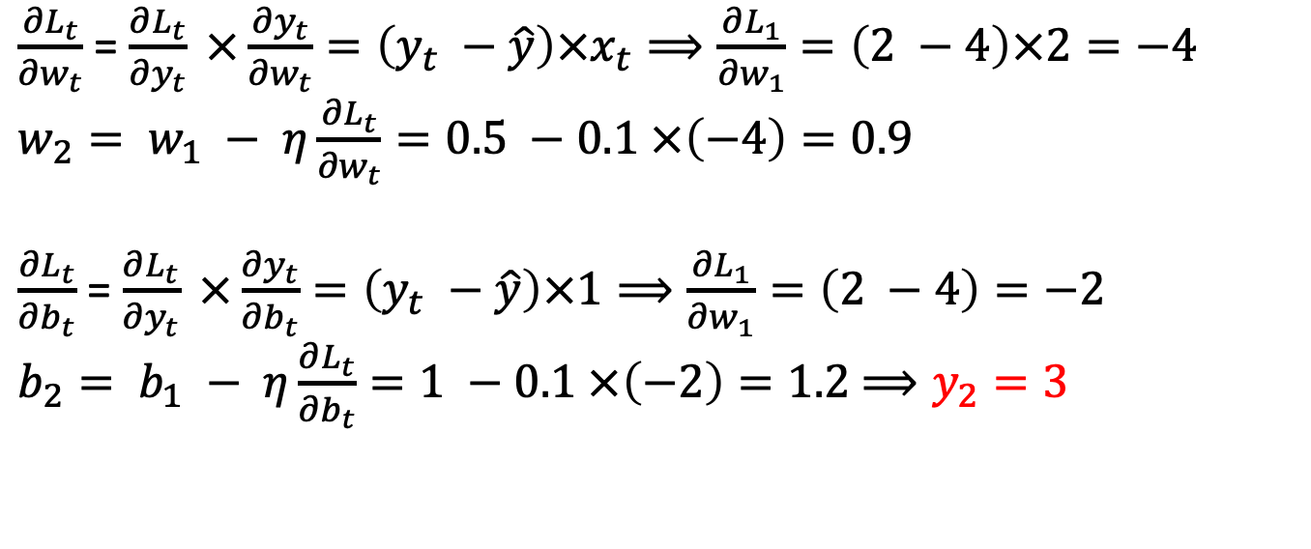
Backpropagation
$$w_{t+1}= w_{t} − η\frac{∂L_{t}}{{∂w}_{t}}$$
$$L_{t}=\frac{1}{2}{(y_{t} −\hat{y})}^{2}$$
$$y_{t}=x_{t}w_{t}+b_{t}$$
$$w_{1}=0.5$$
$$x_{1}=2$$
$$\begin{matrix}y_{1}=2, & \hat{y}=4, & η=0.1\end{matrix}$$
$$b_{1}=1$$
$\frac{∂L_{t}}{{∂w}_{t}}$ = $\frac{∂L_{t}}{{∂y}_{t}} ×\frac{∂y_{t}}{{∂w}_{t}}=\left(y_{t} −\hat{y}\right)×x_{t}⟹\frac{∂L_{1}}{{∂w}_{1}}=\left(2 −4\right)×2=−4$
$w_{2}= w_{1} − η\frac{∂L_{t}}{{∂w}_{t}}=0.5 −0.1 ×\left(−4\right)=0.9$
$\frac{∂L_{t}}{{∂b}_{t}}$ = $\frac{∂L_{t}}{{∂y}_{t}} ×\frac{∂y_{t}}{{∂b}_{t}}=\left(y_{t} −\hat{y}\right)×1⟹\frac{∂L_{1}}{{∂w}_{1}}=\left(2 −4\right)=−2$
$b_{2}= b_{1} − η\frac{∂L_{t}}{{∂b}_{t}}=1 −0.1 ×\left(−2\right)=1.2$ $⟹y_{2}=3$

Slide 31
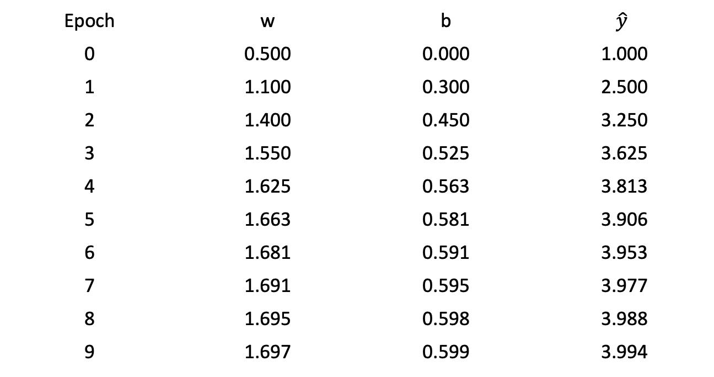
Backpropagation
for x = 2, y = 4, w = 0.5, b = 0:
Epoch | w | b | $$\hat{y}$$
0 | 0.500 | 0.000 | 1.000
1 | 1.100 | 0.300 | 2.500
2 | 1.400 | 0.450 | 3.250
3 | 1.550 | 0.525 | 3.625
4 | 1.625 | 0.563 | 3.813
5 | 1.663 | 0.581 | 3.906
6 | 1.681 | 0.591 | 3.953
7 | 1.691 | 0.595 | 3.977
8 | 1.695 | 0.598 | 3.988
9 | 1.697 | 0.599 | 3.994
Notes:
How many times we’ve visited to the datasets so far.
b/c why we go back and back for accuracy!

Slide 32
Why Deep?
The same number of parameters
Which one is better?
……
……
……
Shallow
Deep

Slide 33
Deep vs Shallow
Compared to shallow networks, deep learning has :
Less Parameters
Various levels of abstraction
  better at generalization
  nested hierarchy of concepts

Slide 34
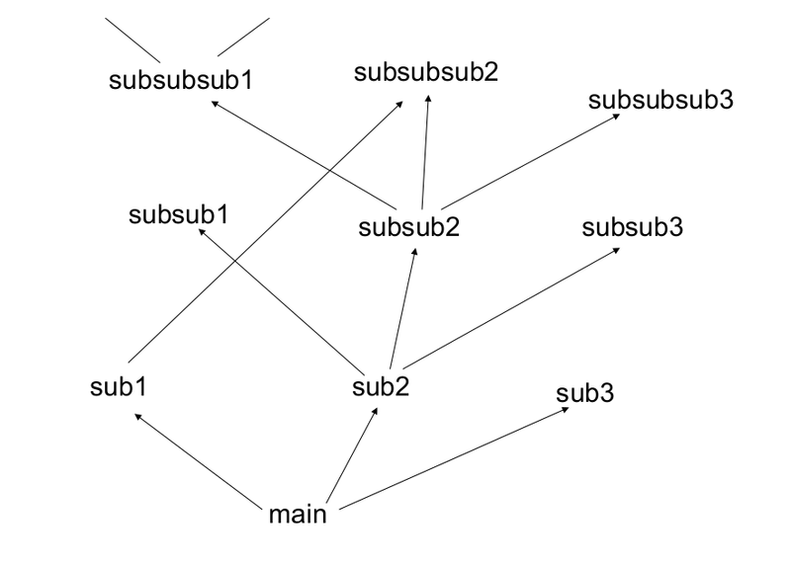
Modularization
Deep → Modularization
Don’t put everything in your main function.
http://rinuboney.github.io/2015/10/18/theoretical-motivations-deep-learning.html

Slide 35
Modularization
Deep → Modularization
Classifier 1
Dogs with
long hair
Classifier 2
Cats with
long hair
Image
Classifier 3
Dogs with
short hair
Classifier 4
Cats with short hair

Slide 36
Modularization
Deep → Modularization
Cat or Dog?
Image
Each basic classifier can have sufficient training examples.
Basic
Classifier
Long or short?
Classifiers for the attributes

Slide 37
Modularization
Deep → Modularization
Classifier 1
Dogs with
long hair
Dog or Cat?
Classifier 2
Cats with
long hair
Image
Basic
Classifier
Classifier 3
Dogs with
short hair
Long or short?
Classifier 4
Cats with short hair
Sharing by the following classifiers as module

Slide 38
Modularization
Deep → Modularization
……
The modularization is automatically learned from data.
……
……
……
……
……
……
The most basic classifiers
Use 1st layer as module to build classifiers
Use 2nd layer as module ……

Slide 39









Modularization - Image
Deep → Modularization
……
……
……
……
……
……
……
The most basic classifiers
Use 1st layer as module to build classifiers
Use 2nd layer as module ……
Reference: Zeiler, M. D., & Fergus, R. (2014). Visualizing and understanding convolutional networks. In Computer Vision–ECCV 2014 (pp. 818-833)

Slide 40
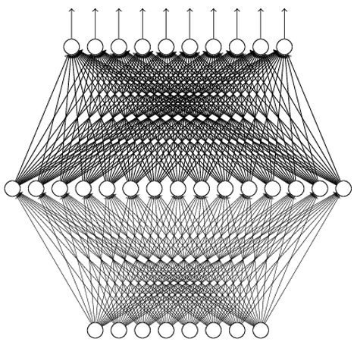
Universal Approximation Theorem
Any continuous function f
Can be realized by a network with one hidden layer
Reference for the reason: http://neuralnetworksanddeeplearning.com/chap4.html
(given enough neurons)
Yes, shallow network can represent any function.
However, using deep structure is more effective.

Slide 41
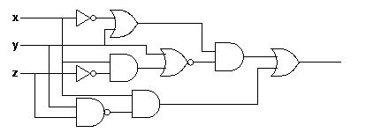
Analogy
Logic circuits
Neural network
Logic circuits consists of gates
A two layers of logic gates can represent any Boolean function.
Using multiple layers of logic gates to build some functions is much simpler
Neural network consists of neurons
A hidden layer network can represent any continuous function.
Using multiple layers of neurons to represent some functions is much simpler
less parameters
less gates needed

Slide 42
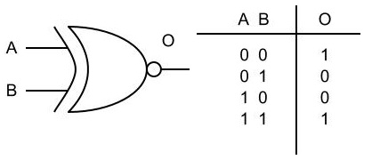
An Example
parity check
Circuit
For input sequence with d bits,
1 0 1 0
1 (even)
Circuit
Two-layer circuit need O(2^{d}) gates.
0 0 0 1
0 (odd)
XNOR
1
0
0
1
0
1
0
With multiple layers, we need only O(d) gates.

